Slide 1
16.32 Project: Optimal Control for Autonomous Drone Racing
by Aleix Paris i Bordas

Slide 2
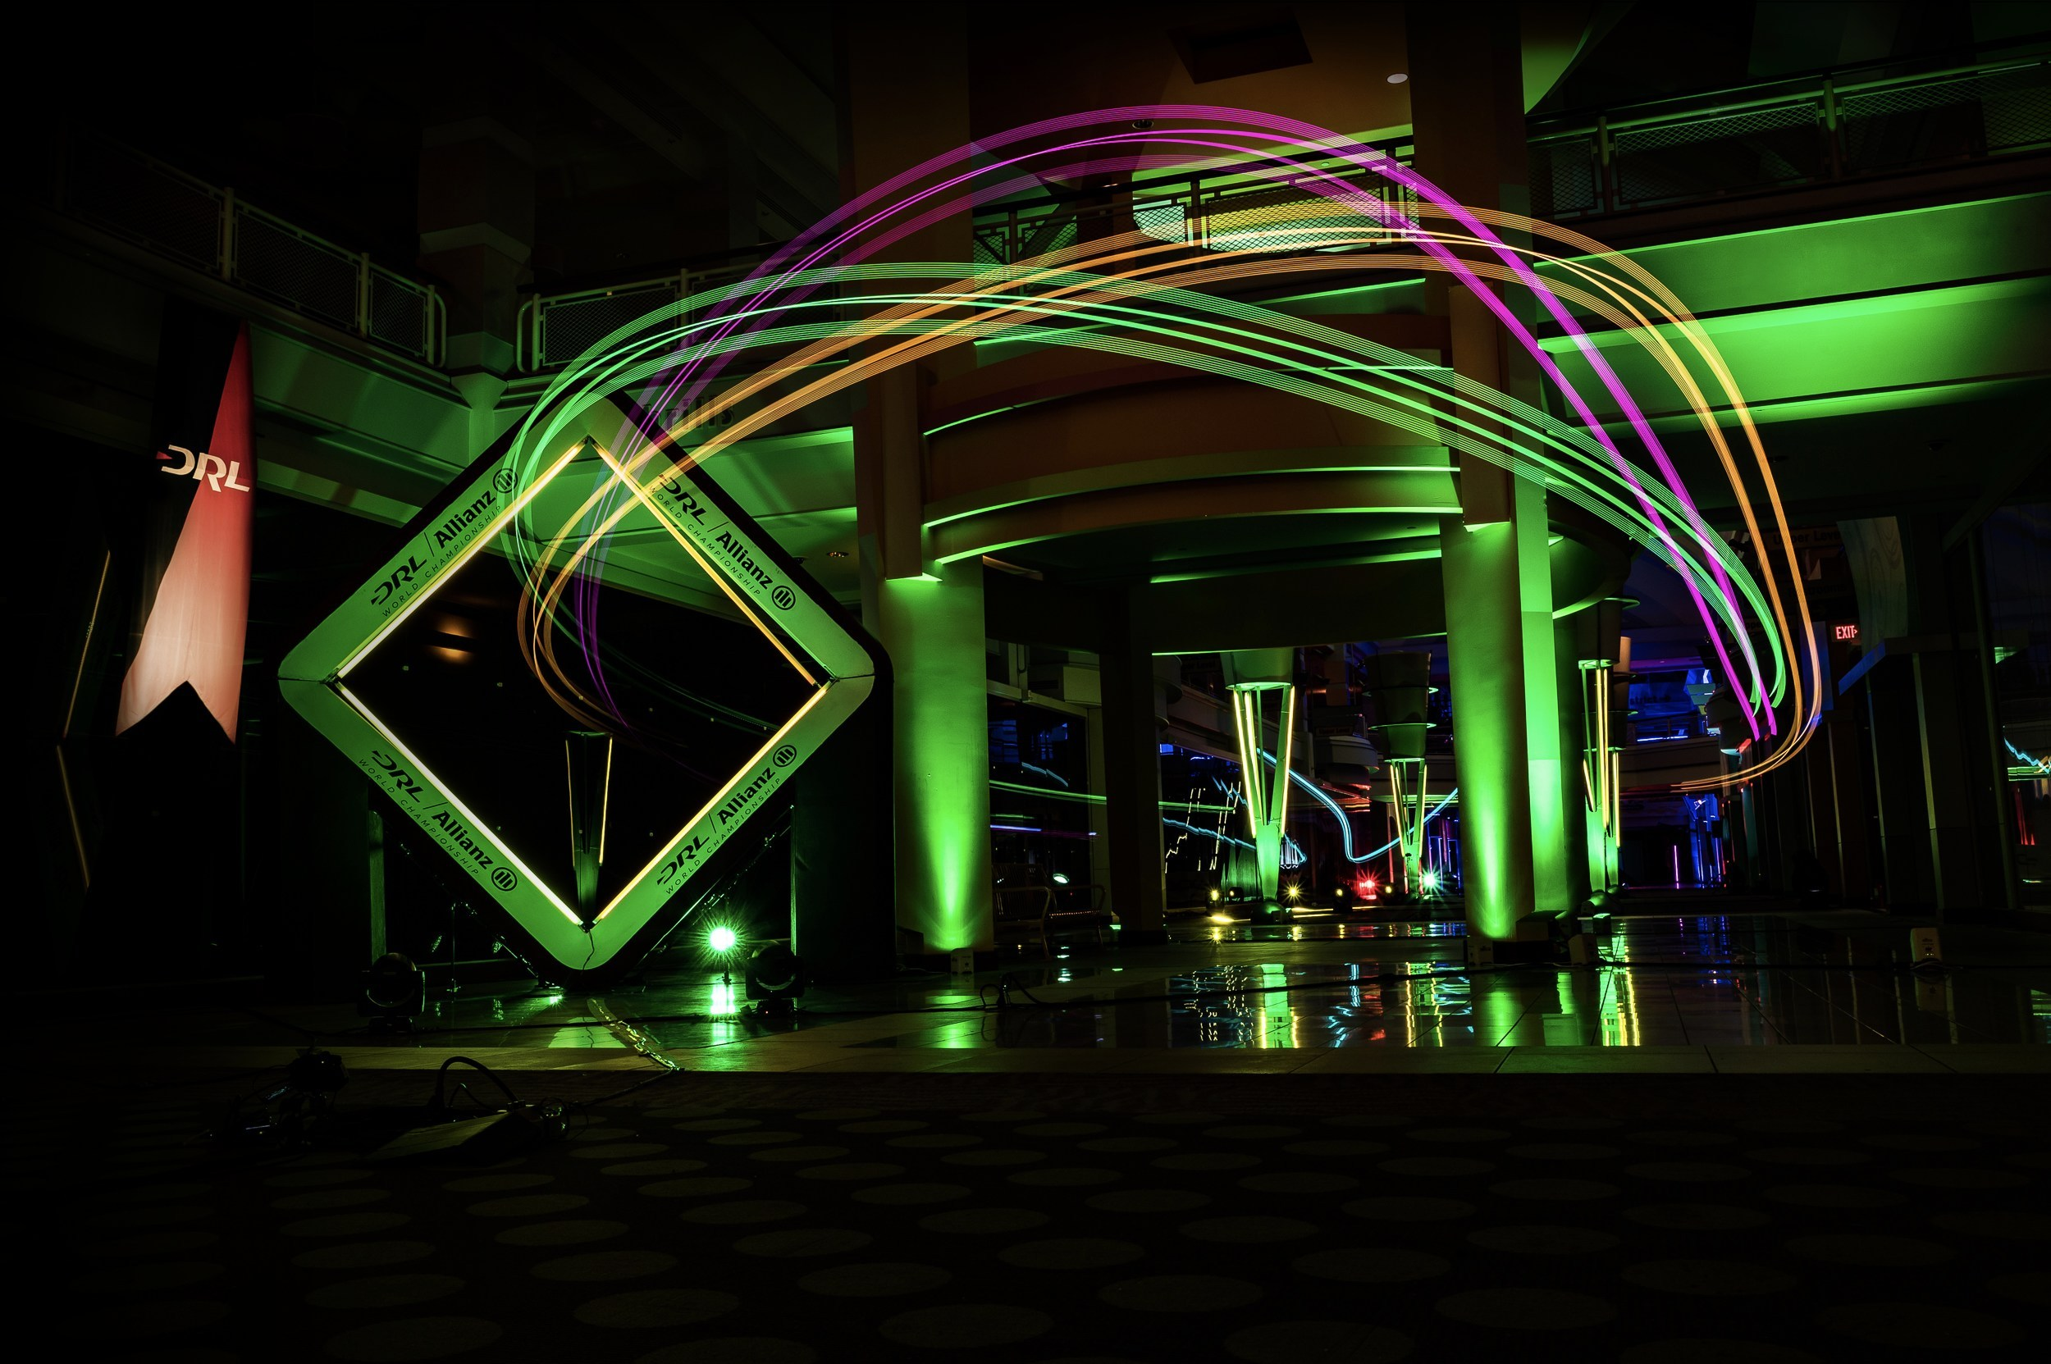
Introduction
Optimal control in aerospace: Red Bull Air Race
In recent years: drone racing
In the following years: autonomous drone racing

Slide 3
Quadrotor Dynamics and State-space Model
Assumptions:
Constant air density and gravity
No wind
No ground effect
Symmetrical quadrotor (diagonal inertia matrix and I_{xx} = I_{yy})
No blade flapping

Slide 4
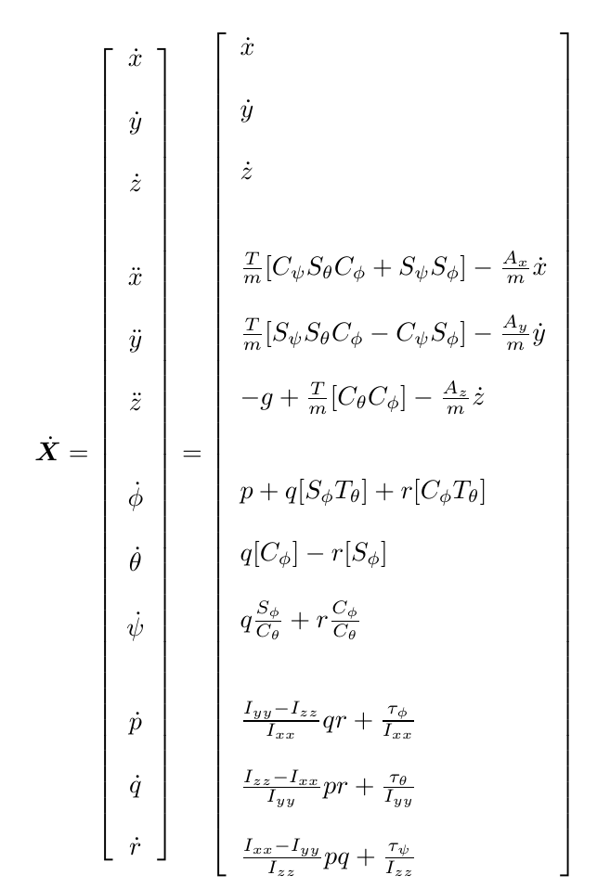
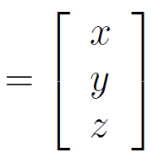
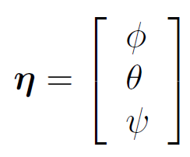
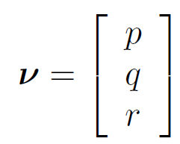
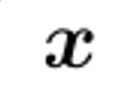
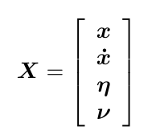
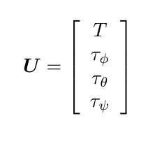
Quadrotor Dynamics and State-space Model
Dynamics derivation from [1]
State-space model: 12 states, 4 control inputs:
[1] Teppo Luukkonen. Modelling and control of quadcopter. Independent research project in applied mathematics, Espoo, 22, 2011.

Slide 5
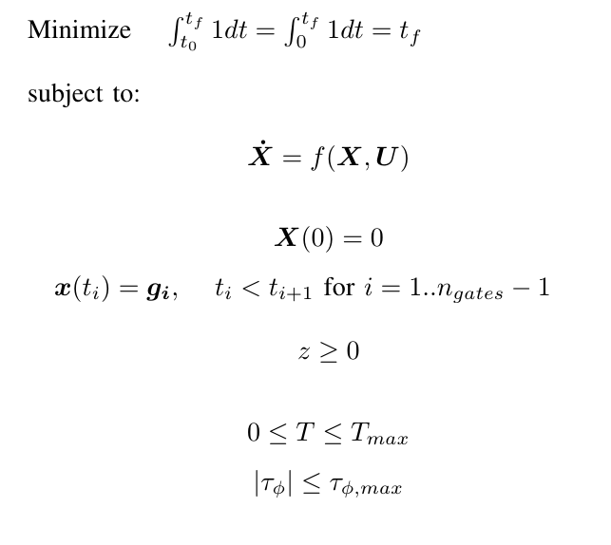
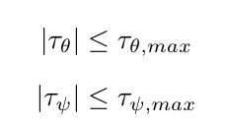
Mathematical Formulation

Slide 6
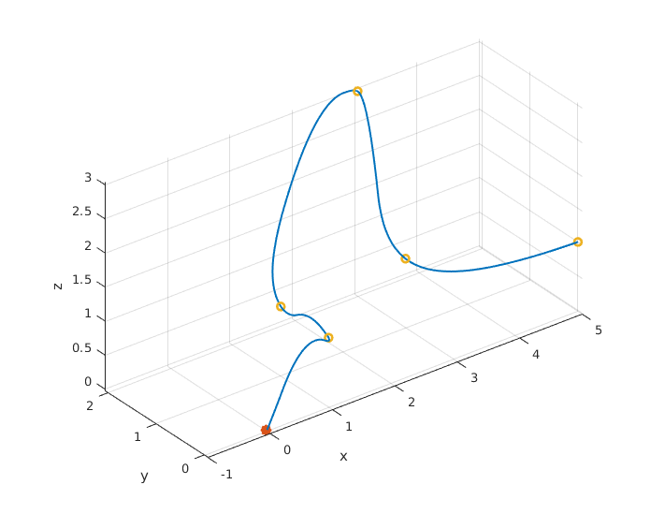
Results

Slide 7
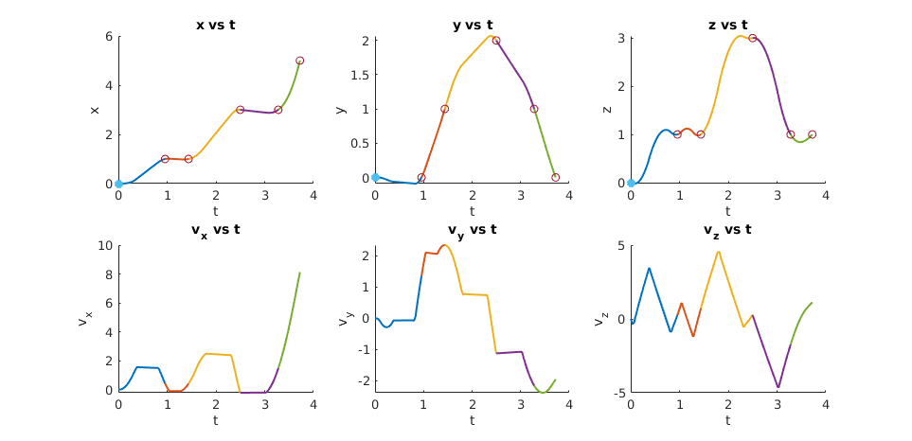
Results

Slide 8
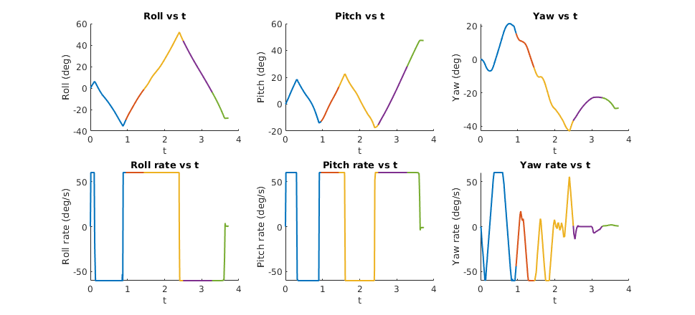
Results

Slide 9
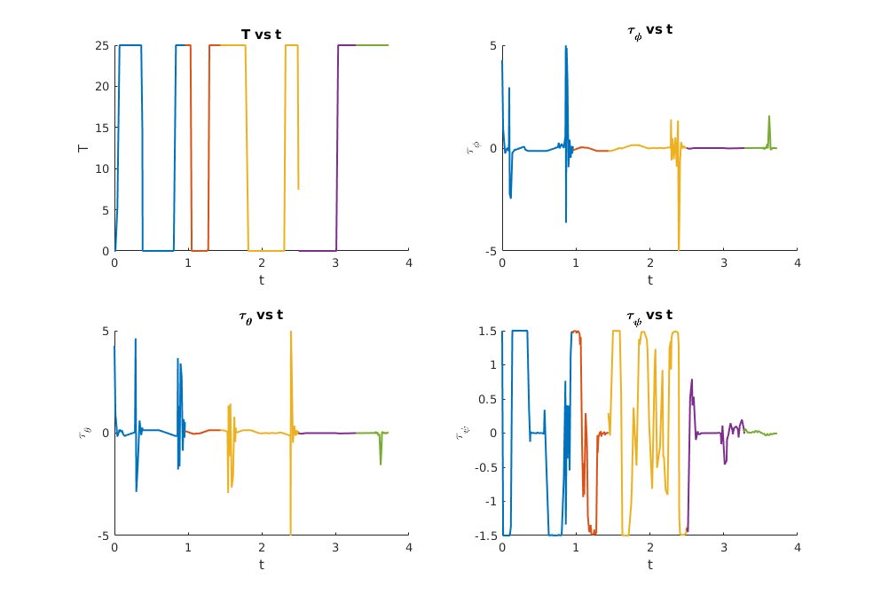
Results

Slide 10
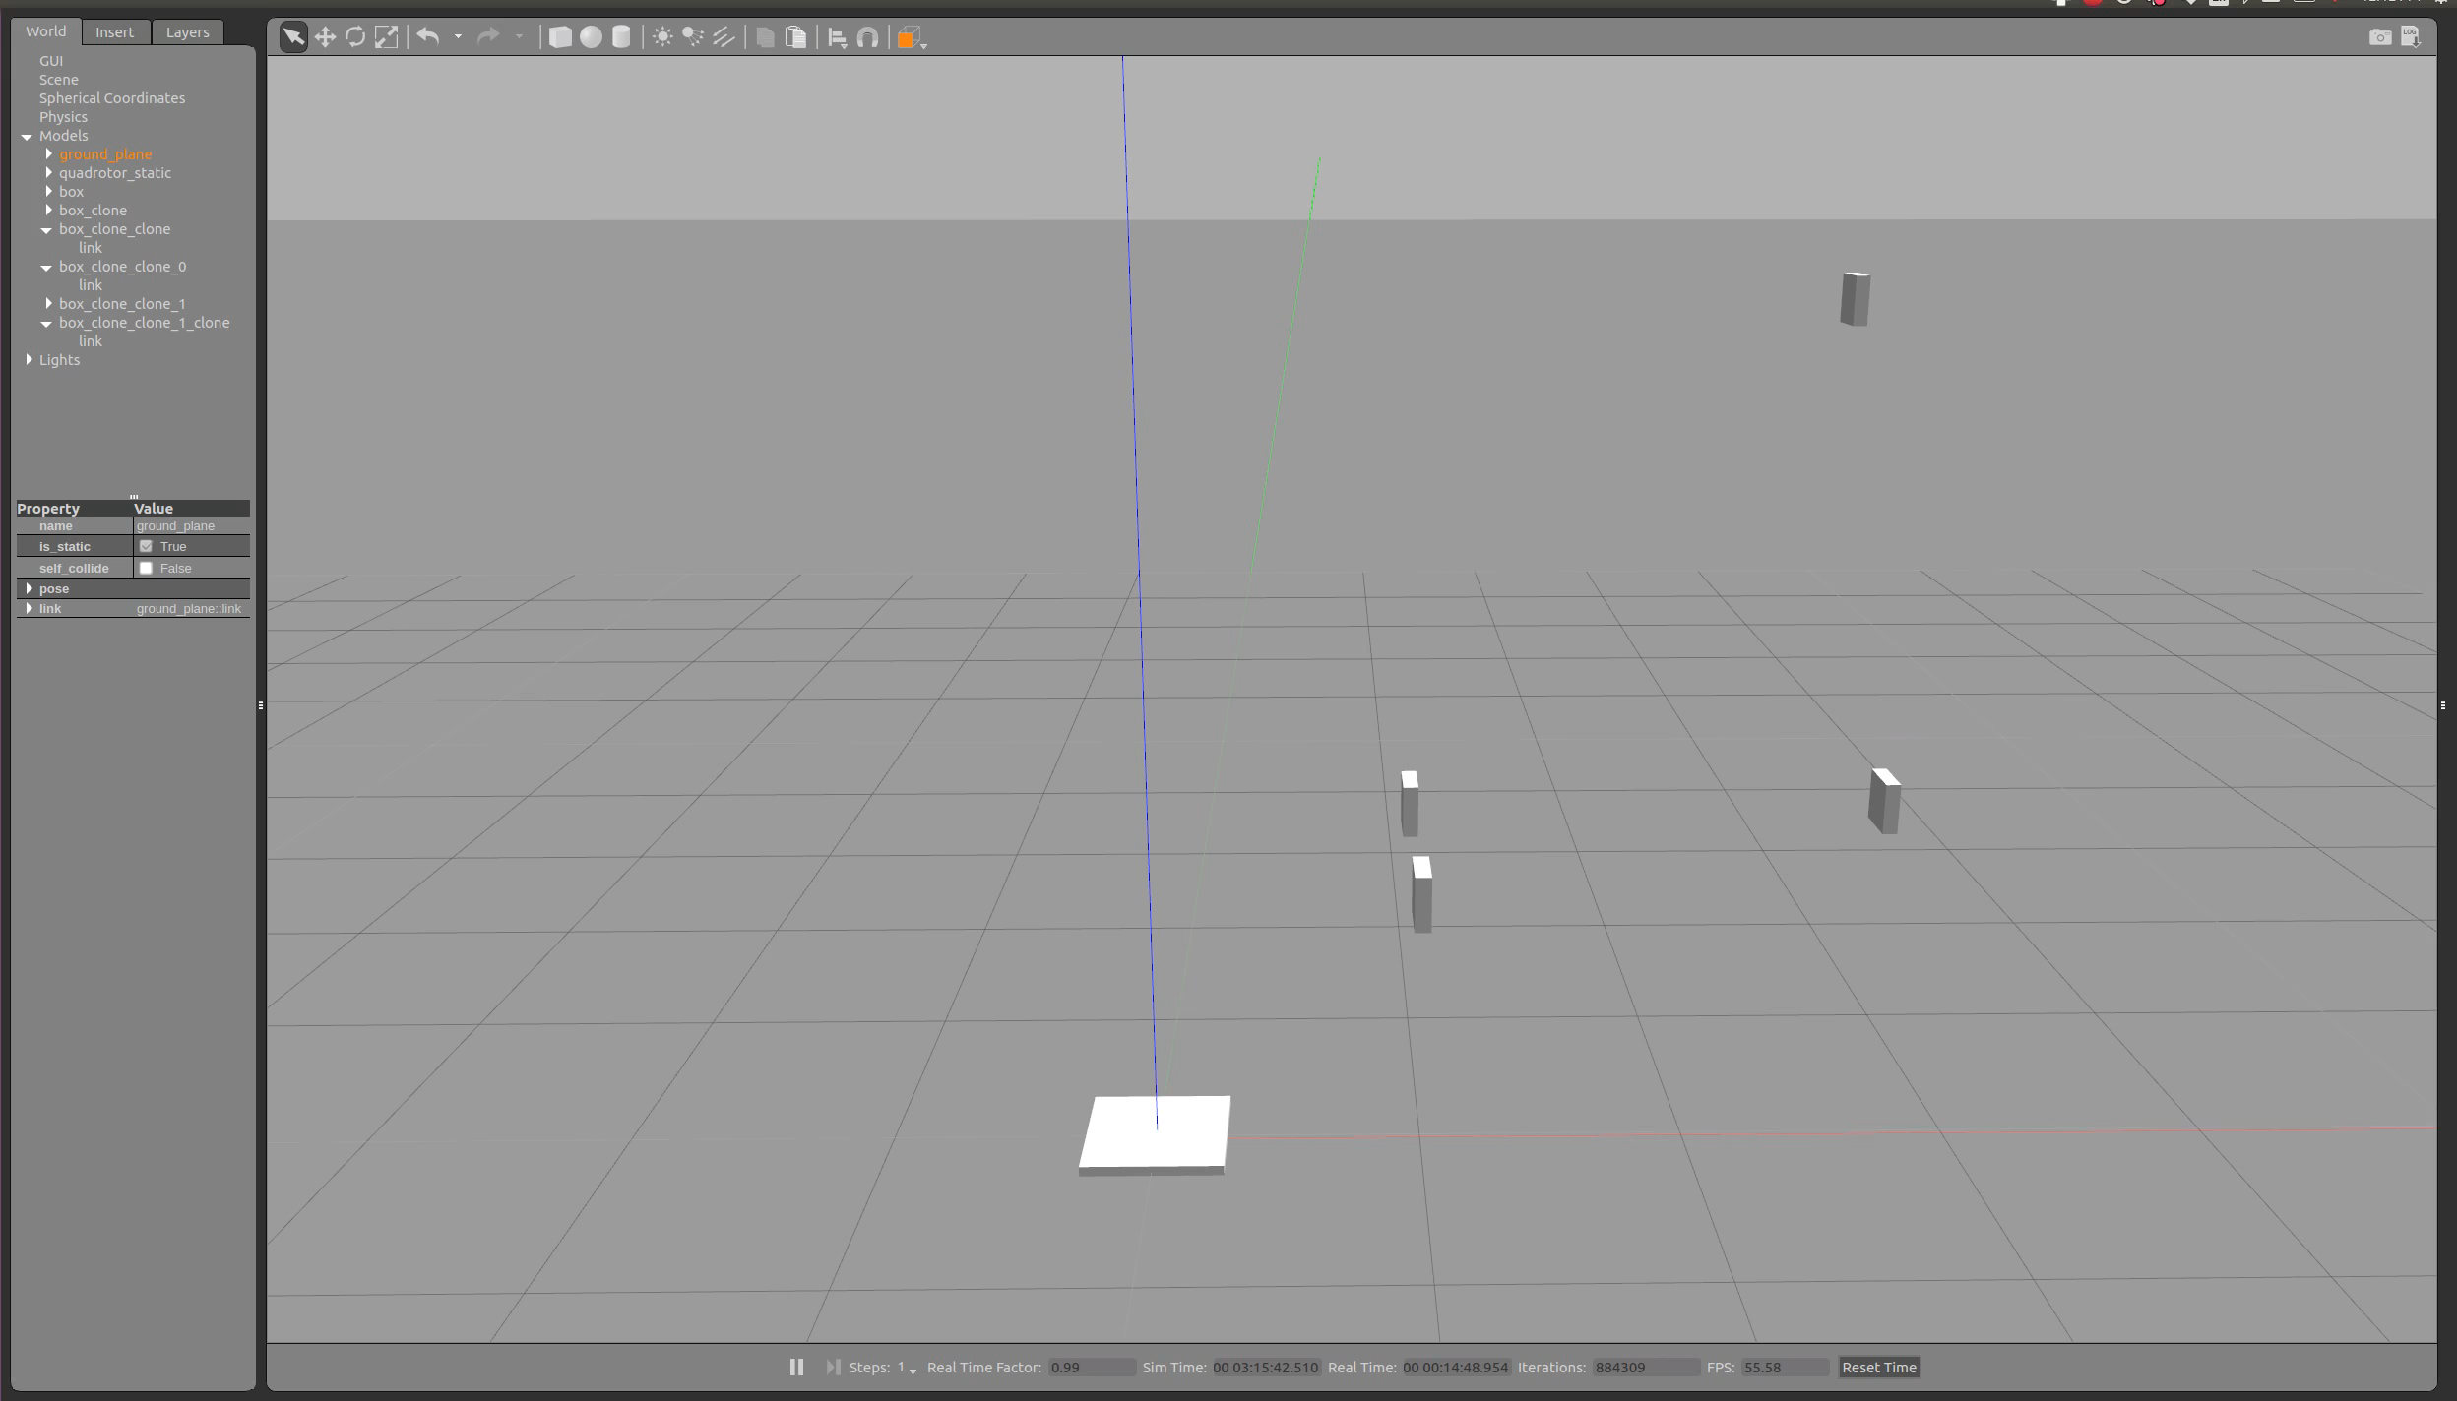
Results

Slide 11
16.32 Project: Optimal Control for Autonomous Drone Racing
by Aleix Paris i Bordas

